Slide 1
自我介紹
nizima Live

Slide 2
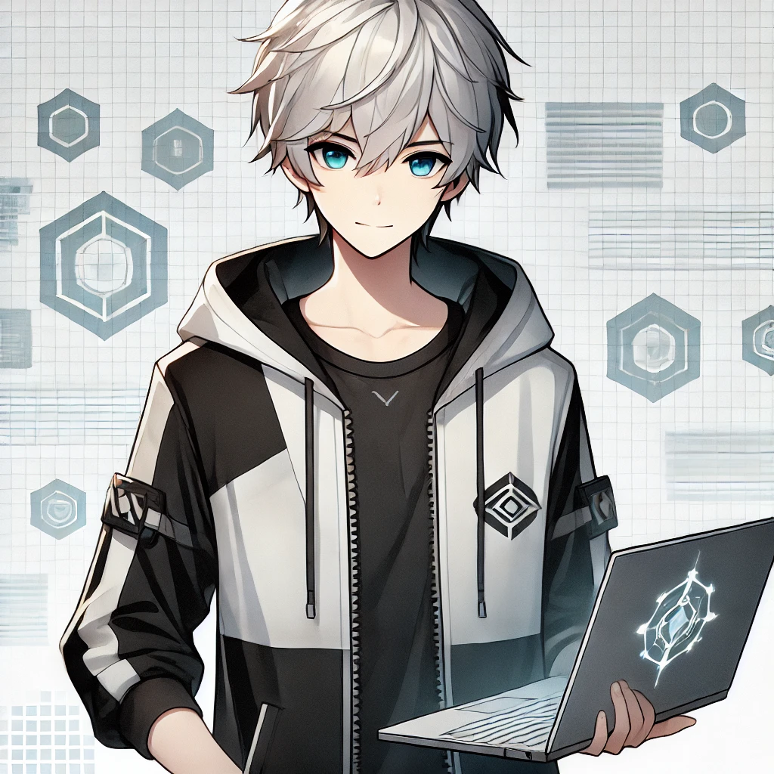
目標
Notes:
A young male character with silver-white hair, blue eyes, standing confidently with a laptop in his hand, wearing a black and white hoodie with a futuristic design. The background features a digital grid or tech symbols, emphasizing his focus on technology and programming. He has a calm and determined expression, ready to tackle challenges.

Slide 3
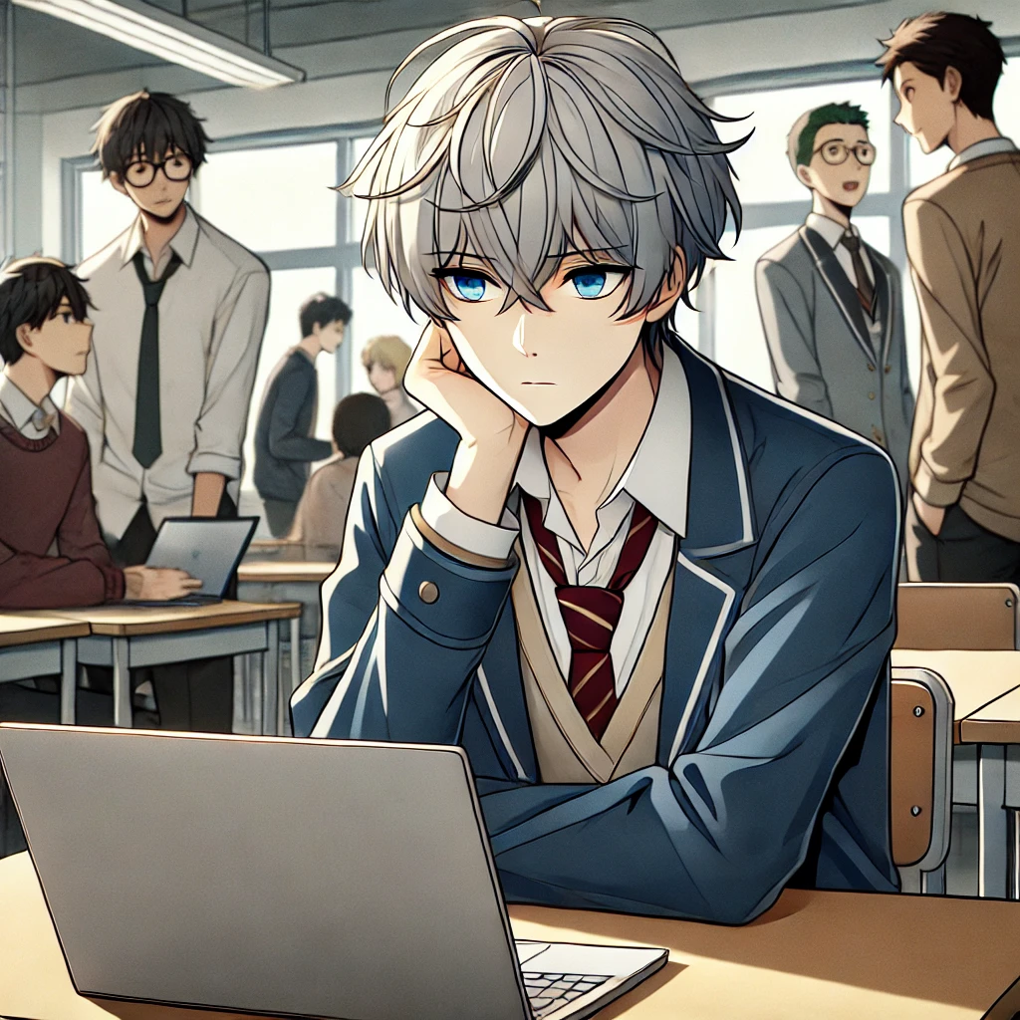
阻礙
Notes:
The same character, now sitting alone at a desk in a school setting. He has a distant expression, with other students in the background working together in groups, while he focuses on his laptop. The contrast between the character’s solitary work and the group dynamics highlights his struggle with teamwork and social interaction.

Slide 4
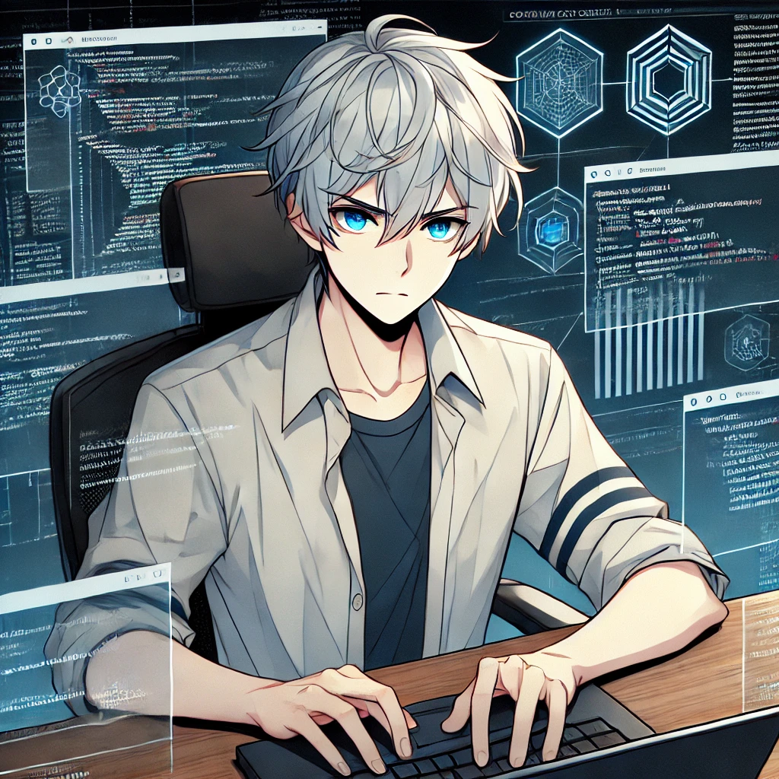
努力
Notes:
The character, fully focused, typing on his laptop with intense concentration. The background shows complex coding or a virtual interface of a cracking tool he is developing for a competition. His determined expression and posture convey his deep focus and independent effort.

Slide 5

結果
Notes:
The character sitting alone on a bench outside the school, holding a trophy in one hand and looking at it with a neutral expression. Around him, students are celebrating with their teams, but he seems more reflective and disconnected from the group energy. The scene captures his quiet success and isolation.

Slide 6
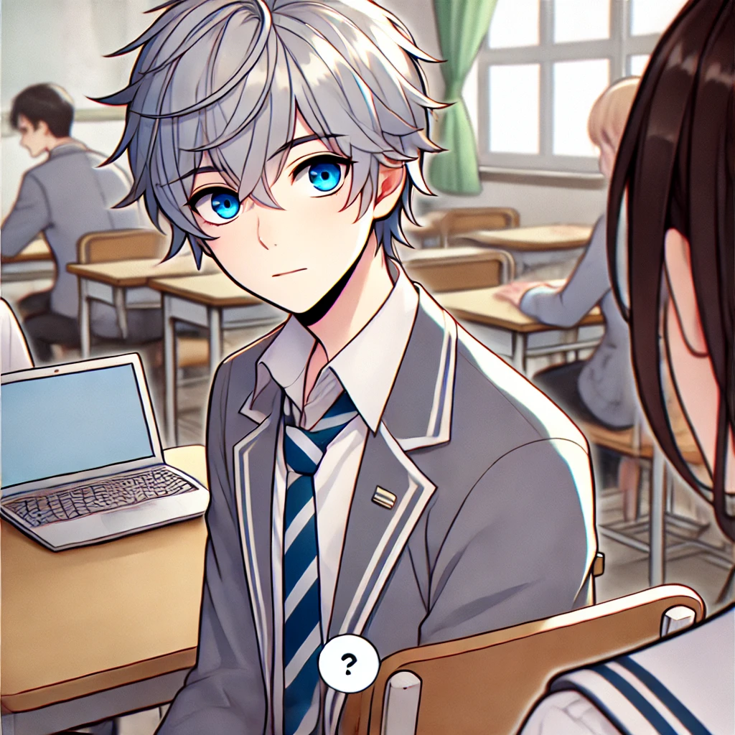
意外
Notes:
The character standing by his desk in a classroom, with a slightly surprised expression as a fellow student approaches him with a friendly smile. The other student is holding a laptop or notebook, clearly seeking help or wanting to collaborate. The background shows a few other students engaged in their activities, while the focus is on the unexpected interaction between the two.

Slide 7
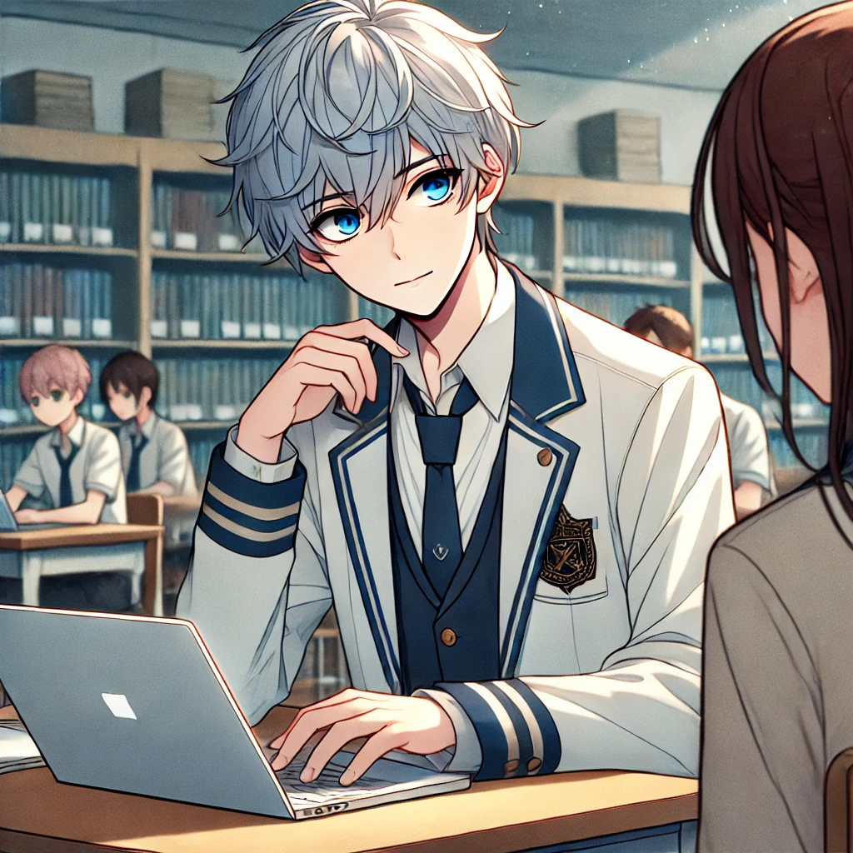
轉彎
Notes:
The character, now sitting with the same student in a classroom or library, showing him some code on his laptop. Both are engaged in a technical discussion. The expression on the character’s face is thoughtful, showing his willingness to teach and collaborate.

Slide 8
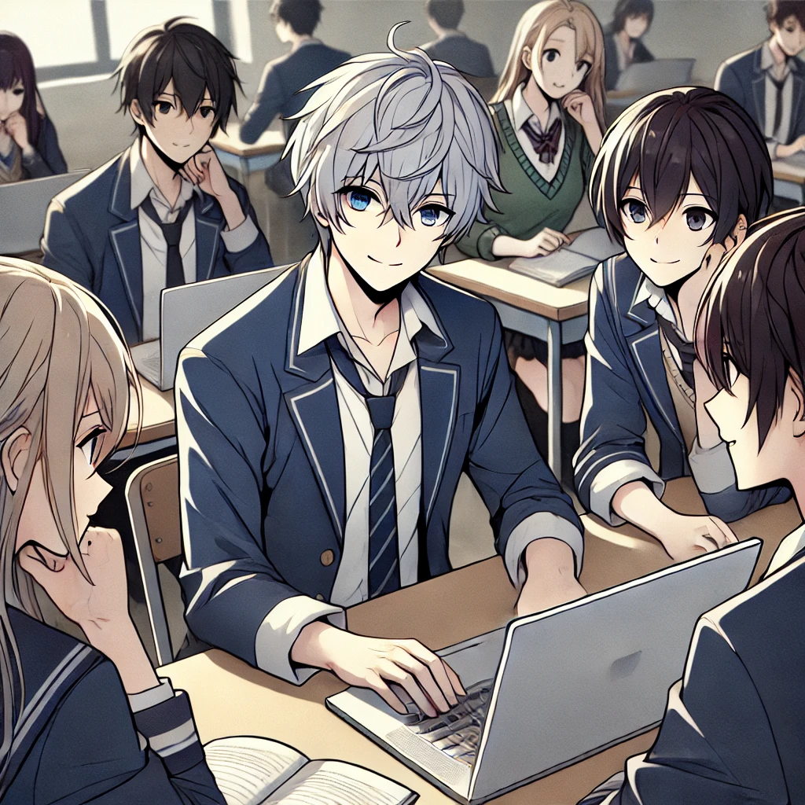
結局
Notes:
The male character with silver-white hair, blue eyes, wearing a school uniform, sits with a small group of students around a laptop in a classroom or study area. He is smiling subtly, actively participating in a discussion with the others, who are also engaged and smiling. The group appears focused yet relaxed, with the laptop as the center of attention. The background shows a few other students quietly working, highlighting the collaborative and productive atmosphere.

